Slide 1

Human Rights Approach to AI
Dr. Jayson S. Lamchek

Slide 2
Human Rights and AI Regulation
[AI’S ISSUES ARE HUMAN RIGHTS ISSUES]
AI affects our human rights.
Not unique to AI: The advancement of Science and Technology affects our human rights.
Example of Science and HR synergies: advances in medicine affect the right to health; information technology changed our media of communications and affected our right to free speech
Advantage of human rights language over ethics: human rights are legal concepts.
[AI HAS ETHICAL AND SOCIAL ISSUES]
AI is affecting our experience of: privacy, sense of individual autonomy, job security, online safety … all of which are aspects of “human dignity” that underpin various human rights…
[HUMAN RIGHTS REFRAME ETHICAL APPROACHES TO A LEGAL APPROACH TO GOVERNING AI]
Ethical frameworks (including Responsible AI and AI for Good) are flexible but unenforceable.
Human rights framework – also flexible but legally obligatory; a bridge between ethical frameworks and legal regulation.
[THERE CAN BE VARIOUS HUMAN RIGHTS APPROACHES]
Toronto Declaration on Machine Learning Systems – emphasis on PROTECTION against potential harms of AI, very similar to Responsible AI approach, centered on “core human rights principles” such as non-discrimination.
“Right to Science” approach – treats AI as a technology or set of technologies, balances THREE main interests.

Slide 3

HUMAN RIGHTS
A HUMAN RIGHT TO AI:
AI should serve humanity/human rights
”HUMAN DIGNITY”
CIVIL AND POLITICAL
ECONOMIC, SOCIAL AND CULTURAL
GROUP RIGHTS
CROSS-CUTTING
LIFE, BODILY INTEGRITY, LIBERTY, SAFETY
SELF-DETERMINATION
SCIENCE
WELFARE
Science should serve humanity/human rights
Implied aspect: To be protected from harmful applications of science
To enjoy the benefits of scientific progress and its applications
To participate in science
Social protection system against unemployment, sickness, etc.
Work-related rights
Health
Education
Adequate Standard of Living
Culture and the Arts
Indigenous rights
Right to development
Protection from harm
Benefit-sharing
Participation in AI
Not to be deprived of life or liberty without legal process (criminal process rights)
Not to be tortured
Privacy
Freedom of speech/expression and information
Non-discrimination on basis of race, gender, etc.
PROTECTION: AI that harms humans/human rights doesn’t benefit humanity and shouldn’t exist
BENEFIT-SHARING: AI’s benefits should be shared with everyone;
PARTICIPATION: Everyone should have a say in how AI is used to benefit humanity.
Notes:
This slide shows how Streamline helps deliver on the Deakin Research and Innovation Guiding Plan and, in turn, Deakin 2030
As you'll see on the left, we'll deliver for the University by transforming research admin systems, processes and data quality and accessibility for Deakin Research
On the right is our Vision, which is an enabler to achieving these strategic goals
The Streamline Vision is for a high performing Deakin Research through better ways of working, which will positively impact our three key stakeholder groups: researchers, support staff and Higher Degree by Research students
Better ways of working will help these groups live and breathe the four success factors identified by DVCR Julie Owens - also known as the Four Cs – that will ensure the future sustainability of Deakin Research: Customer Focus, Capability, Capacity and Confidence

Slide 4
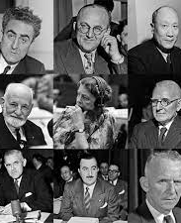
Science as a Human Right
Universal Declaration of Human Rights:
Art. 27. (1) Everyone has the right … to share in scientific advancement and its benefits.
International Covenant on Economic, Social and Cultural Rights:
Art. 15. 1. The States Parties to the present Covenant recognize the right of everyone:
(b) To enjoy the benefits of scientific progress and its applications
Efforts at implementation:
Campaign over Access to HIV drugs
UN Committee on ESCR, General Comment No. 25 (2020)
Campaign over Access to COVID vaccines

Slide 5
Science should serve humanity/human rights
Implied aspect: To be protected from harmful applications of science
To enjoy the benefits of scientific progress and its applications
To participate in science
Traditional areas of science and tech policy:
Rights of scientists [x]
Access to scientific knowledge [x]
Structural barriers against scientists in developing countries [x]
Public investment in science and technology [partly]
New areas of policy in the age of AI:
Privacy as Property
New forms of Taxation, e.g., data taxation
Universal Basic Income
Citizen Science

Slide 6
PROTECTION FROM HARM
AI should serve humanity/human rights
The Right to Science implies a state duty to work against harmful applications of science, including AI.
Some of examples of legal developments in this area:
- Privacy laws and their enforcement against Big Tech practices/ business model
(e.g., Cambridge Analytica cases; Meta Ireland case; Italy’s ChatGPT ban)
- EU’s Artificial Intelligence Act
What to do with Data monetization: two opposed views
RtS-based: Data monetization is harmful to privacy; Big Tech’s “surveillance capitalism” must end.
Non-RtS-based: Data monetization and privacy can be made compatible through contractual arrangement (“data trust”) between individual data subjects and Big Tech.

Slide 7
BENEFIT-SHARING
AI should serve humanity/human rights
When corporations use AI to convert scientific knowledge into profits, the Right to Science implies a state duty to establish a benefit-sharing scheme to access such profits, such as a universal basic income funded from the taxation of tech companies.
    Early examples of “benefits of scientific progress”: essential drugs and vaccines (e.g., HIV drugs); scientific knowledge.
    Data Monetisation is an application of AI that primarily produces monetary benefits.
    Universal Basic Income (UBI) scheme shares monetary benefits universally, i.e., to everyone unconditionally, i.e., without need to work.
    Growing evidence of effectiveness of UBI exists, but funding UBI is debated.
How to do Taxation of Big Tech: two views
RtS-based: Taxation to fund UBI redistributes AI’s benefits to everyone.
Taxation co-exists with the duty to work towards ending harmful data monetisation practices.
Non-RtS-based: Data taxation is based on seeing data as a valuable resource (“new oil”) and sharing that value with data producers.

Slide 8
PARTICIPATION IN AI
AI should serve humanity/human rights
The Right to Science implies a state duty to facilitate people’s participation in the development of AI.
  Under-production of socially good AI: Applications of AI by non-profits, UN agencies (AI for Good), public bodies, etc. may produce social benefits that corporations are not interested in.
  Participation in priority setting: People can/should participate in identifying applications of socially good AI that should be prioritised for development, e.g., Barcelona’s DECODE project.
  Citizen science or scientist-advocates?: Even when given access to the necessary tools, it is doubtful whether ordinary people can do data analytics as well as technical experts, or would want to. It will be more effective to ensure ordinary people had access to technical experts who could represent and translate their interests.
Is “AI for Good” Really Good: two views
Non-RtS-based: “AI for Good” defines an AI application as good because it is intended to support the achievement of some Sustainable Development Goal (SDG), which is universally-agreed upon as good.
RtS-based: “AI for Good” may still be bad, for example, if it is dependent to harmful data extractivist social relations; it needs to intentionally incorporate participative mechanisms.

Slide 9
Conclusion
​
In practical terms, to realise the Right to Science approach to AI (Human Right to AI):
States should develop the legal content of the Right to Science, e.g., through legislation or litigation.
Human rights advocates should intervene in new policy debates such as Universal Basic Income, Taxation of Big Tech, Privacy as Property, and AI for Good.
The Right to Science provides a comprehensive legal approach to governing AI. It treats three interests of ordinary people as equally important and mutually reinforcing: protection from harmful AI, benefit-sharing and participation in AI.
The Human Right to AI articulates an agenda for placing ordinary people’s interests at the forefront of AI development.

Slide 10
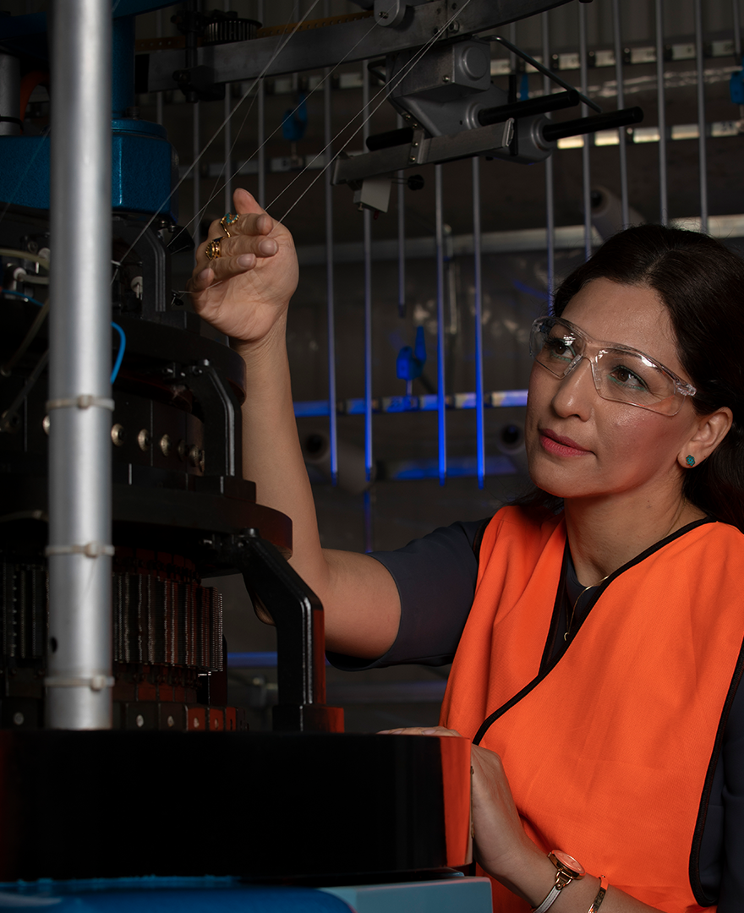
Questions and feedback

